Slide 1

WEB PROJECT Medcare
Presented by- under the guidance of-
Manav Kaushal
Abhilash kumar Ajay K. Patwa
Anshu kumar

Slide 2
Table of Content
Roadmap
Problem Statements
Description
Software Used
Flowchart
Usage and future of project
Work done in all phases
Sneak Peak of project
References

Slide 3
Roadmap-
November 2022
Selection of Topic
Layout Design
January 2023
Coding
February 2023
Testing
December 2022

Slide 4
Problem Statement
Requires a Website For the
Status of hospital
Record of hospitals
Review of hospital
About the hospital
An easier method for booking of Appointments

Slide 5
Description
The project Medcare is based on the topic of hospital management
Which provide the user basic information needed for a hospital
Example- Facility , top Doctors, Status of hospital, Appointment issues, user Experience, etc.

Slide 6




Software used
HTML
CSS
JavaScript

Slide 7
Usage and Future scope of project
The project provides the user better experience for an overview of a hospital facility ,reviews ,procedure for booking an appointment,
Doctors , location, contact details , etc.

Slide 8
Work done in Phases
Phase -1
Selection of topic
Research on topic
Phase-2
Create A basic structure of website using HTML 5
Added Header ,body ,footer.
Phase-3
Designing of site using CSS
Adding logic to the site using JavaScript
Phase-4
Finalisation of project
Verification of project from the co-ordinator

Slide 9
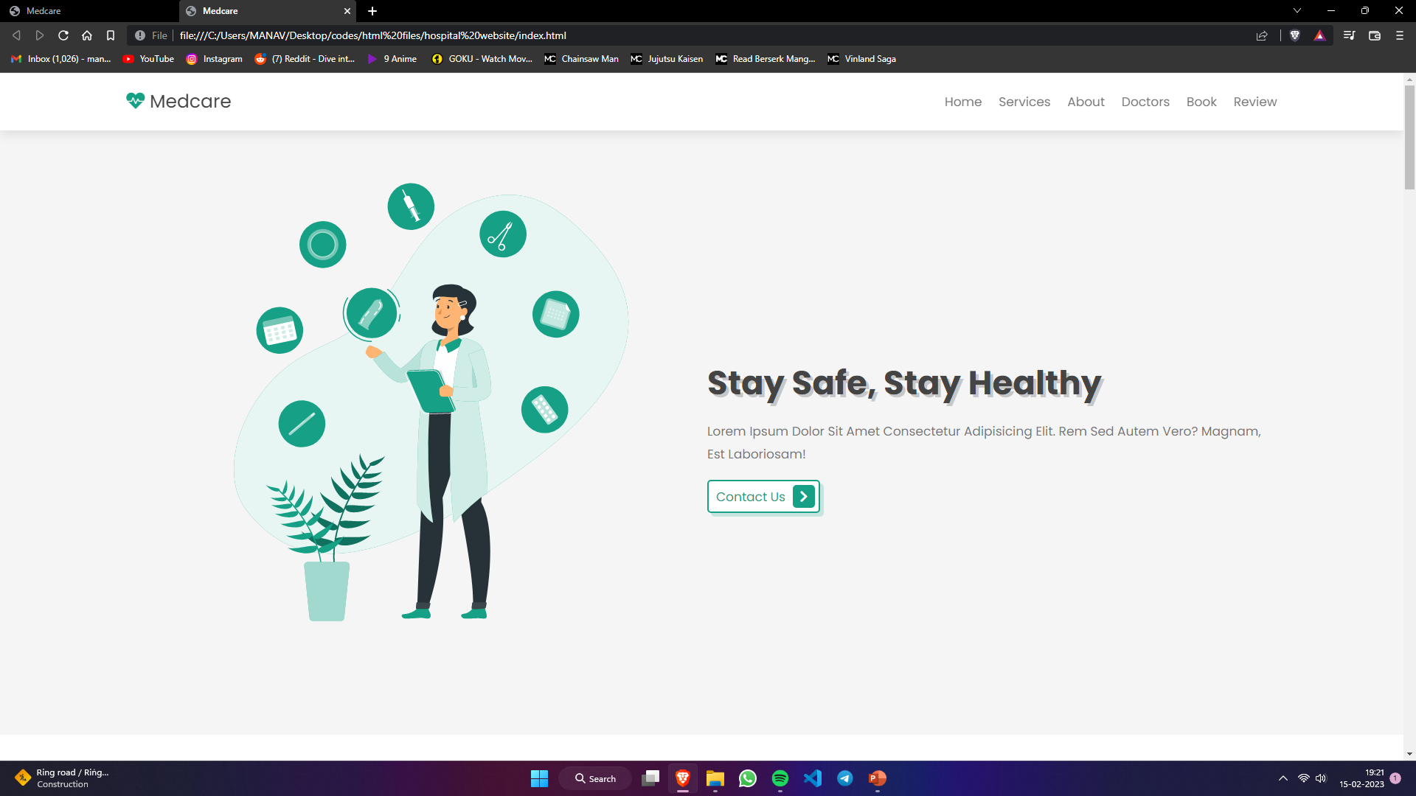
Sneak Peak to the Project
Home page

Slide 10
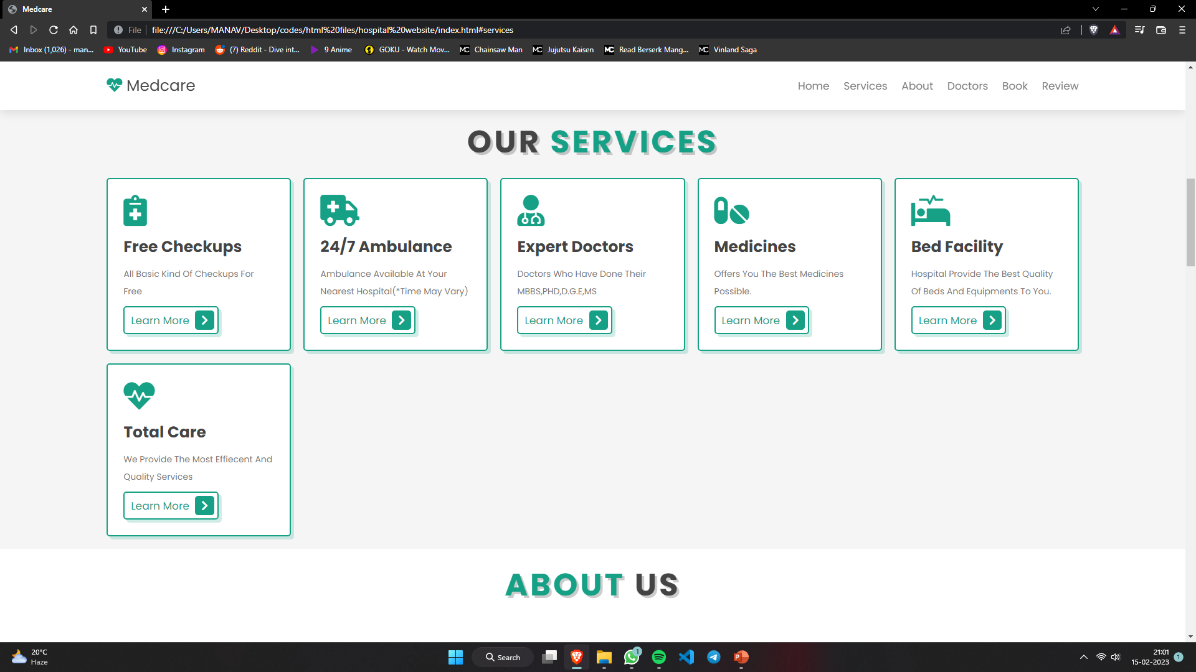
Service Page

Slide 11
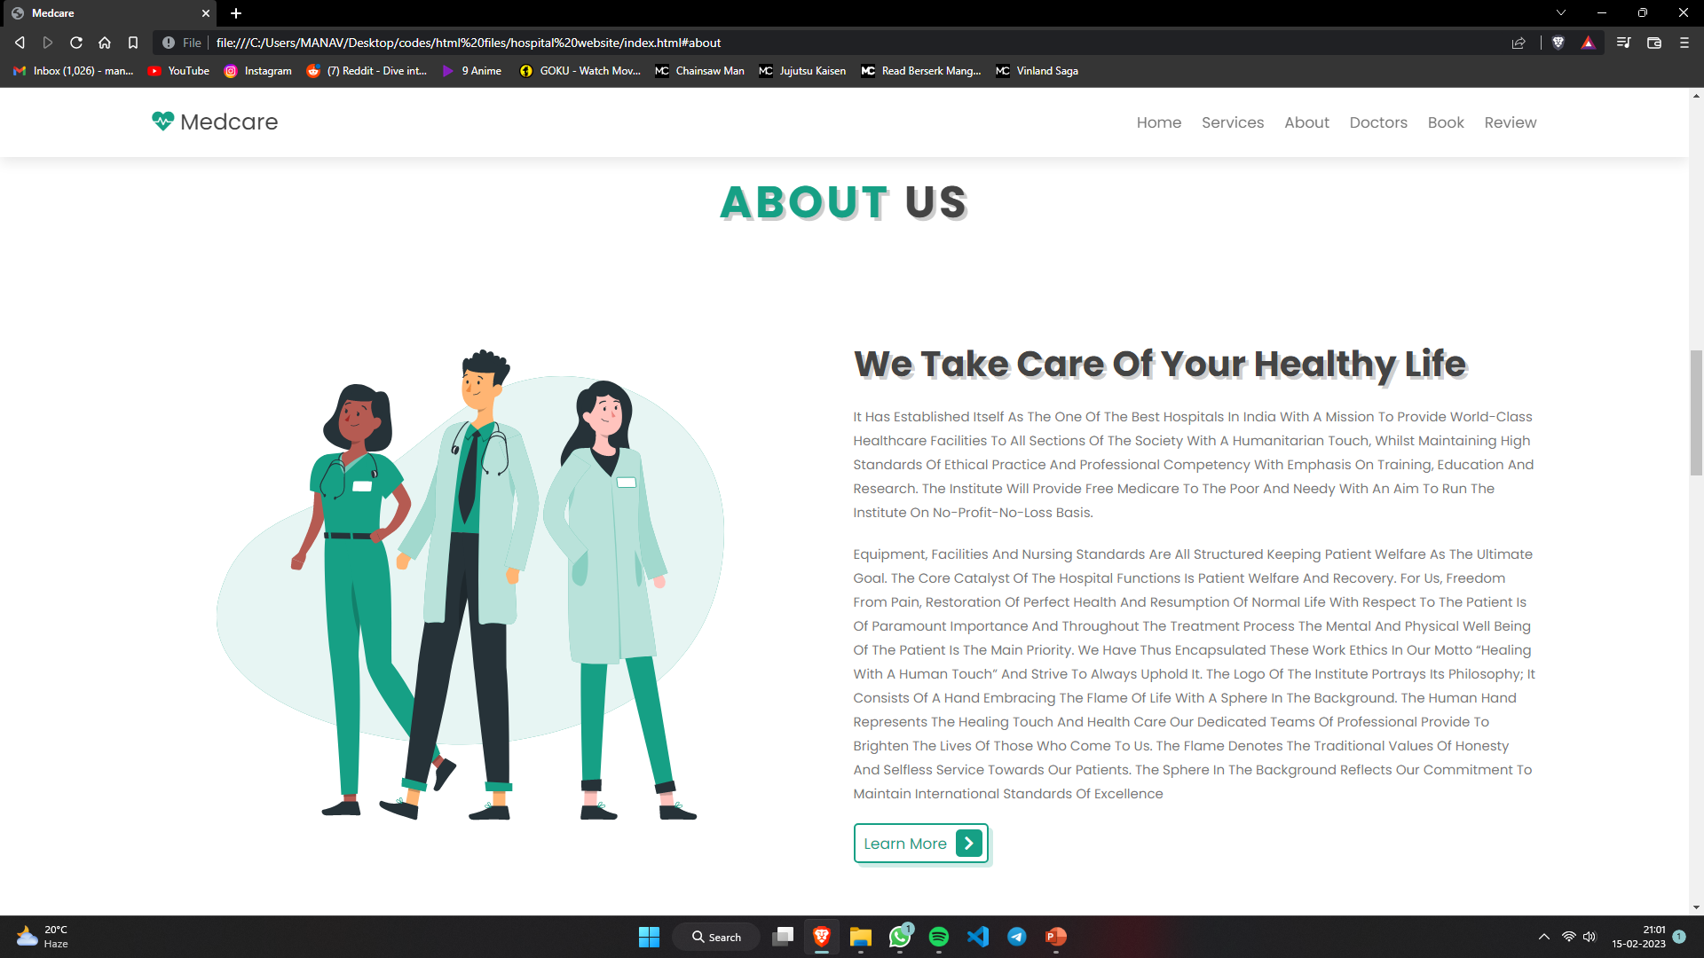
About US Page

Slide 12
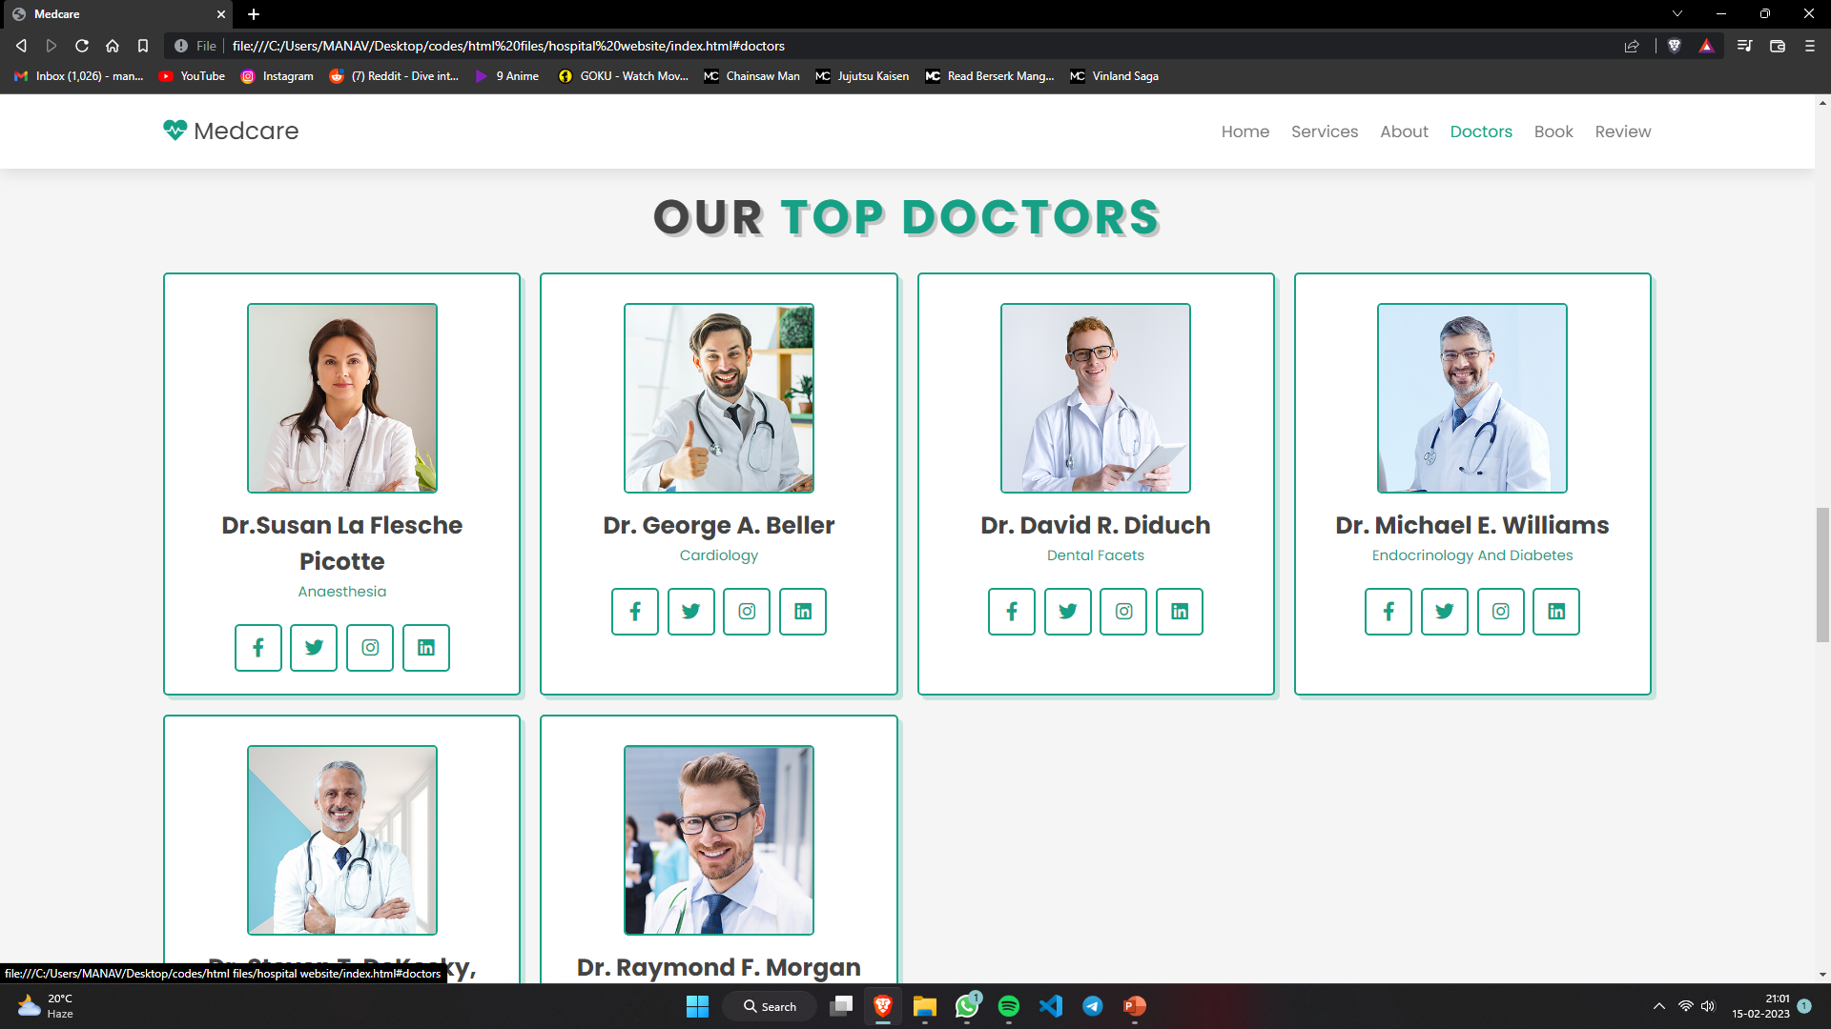
Doctors Page

Slide 13
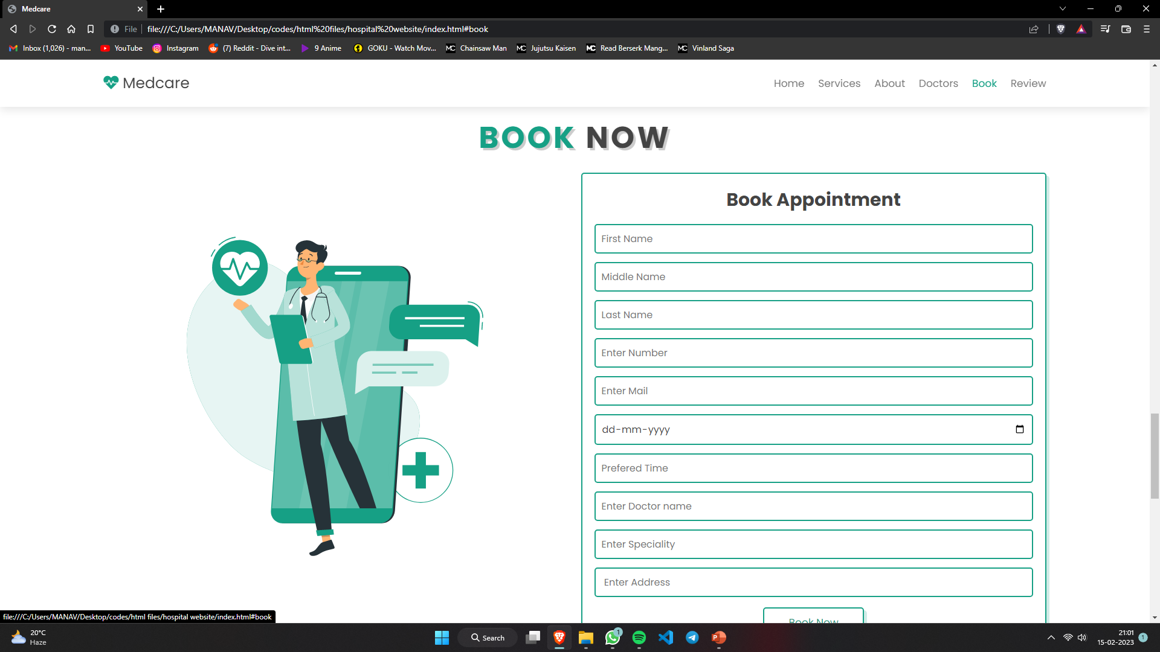
Appointment Page

Slide 14
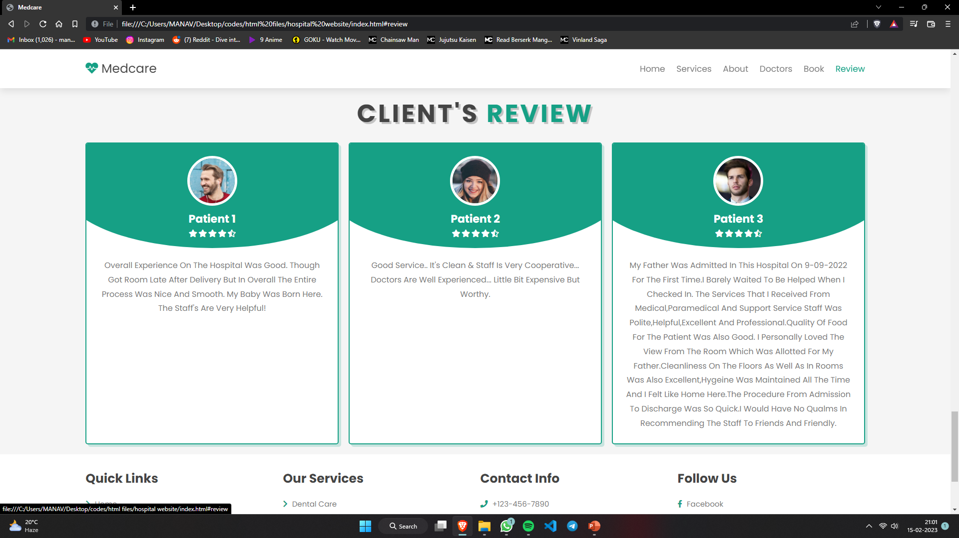
Review Page

Slide 15
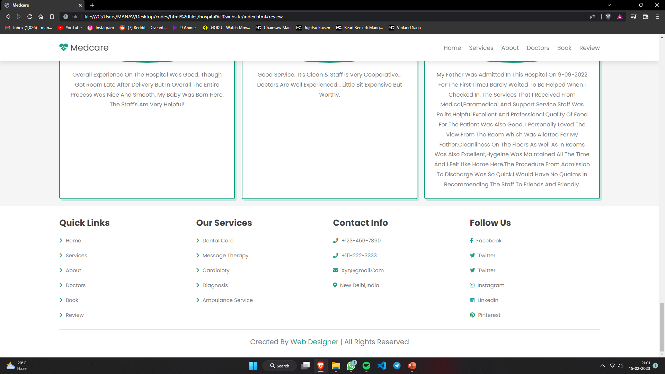
Footer section

Slide 16
References
www.google.com
www.w3schools.com
www.javapoint.com
www.fontawsome.com
www.unsplash.com
www.youtube.com

Slide 17
Thanks!!!
DO YOU HAVE ANY QUESTIONS?

